Slide 1

Digital Library System
D L S

Slide 2
Contents
Abstract
Introduction
Objectives
Existing System
Proposed System
Software and Hardware Requirement
Screenshots
Conclusion
Presentation Title

Slide 3
Abstract
The Digital Library System (DLS) is an online platform designed to efficiently manage and facilitate book-related activities in a library. The system offers users a user-friendly interface to browse, search, and borrow books, while also providing administrators with tools to manage the library's inventory and track borrowing records. Users can create accounts, log in, and access personalized services such as tracking borrowed books and receiving notifications for overdue items. The system provides a comprehensive book catalos with detailed information and real-time availability updates. Administrators can add and update books, generate reports, and monitor library performance. The DLS leverages modern technologies for scalability, reliability, and security, making it accessible through web browsers for easy access from any device. It revolutionizes traditional library operations, simplifying book management and enhancing the overall library experience

Slide 4

Introduction
The Digital Library System (DLS) is a robust and user-friendly platform designed to streamline the management of books and facilitate efficient borrowing and return processes in a library. Developed with the goal of simplifying the tasks of librarians, DLS empowers them with comprehensive tools to effectively organize and administer the library's collection.

Slide 5
Objectives
Automation of Library Management: The DLS aims to automate various tasks performed by a library manager, such as book cataloging, record-keeping, and due date management.
User Registration and Authentication: The project enables users to register and create personal accounts. Upon registration, users can log in to the system using their credentials, which allows them to access their borrowing history and due dates.
Borrowing Management: The DLS provides functionalities for users to borrow books from the library. Users can search for available books, select the ones they want to borrow, and complete the borrowing process online. The system keeps track of borrowed books and due dates.
Due Date Notifications: The project includes a notification system that sends reminders to users about upcoming due dates. Users will receive timely notifications informing them of the books they need to return, helping them avoid late returns and associated penalties.

Slide 6
Existing System
The existing system refers to the current state of library management processes and technologies that are in place before the implementation of the Digital Library System (DLS) project. The existing system may vary depending on the specific library or institution being considered. However, common characteristics of traditional library management systems include: Manual Book Cataloging, Manual Borrowing and Return Process, Lack of Advanced Search Capabilities, Manual Record-Keeping.
Disadvantages
Risk in the management of the data.​
Less User-friendly​.
Accuracy not guaranteed​.

Slide 7
Proposed System
The proposed system, the Digital Library System (DLS), aims to revolutionize library management by introducing a comprehensive and user-friendly digital solution. The key features and improvements of the proposed system include: Online Book Catalog, Advanced Search Functionality, Automated Record-Keeping, User Accounts and Borrowing Management.
Advantages
The system excludes the use of paper work by managing all the book information electronically.
Admin can keep updating the system by providing the new books arrival in system and their availability.
Thus, it saves human efforts and resources.

Slide 8
HARDWARE REQUIREMENTS: Processor : intel 3 Motherboard : intel 915gvsr chipset board Ram : 4 gb ddr2 ram Hard disk drive : 160 gb
Software and Hardware Requirement
SOFTWARE REQUIREMENTS:
Front end : html5, css3, bootstrap
Back end : php, mysql
Control end : angular java script
PHP TOOLS:
xampp-win32-5.5.19-0-VC11

Slide 9
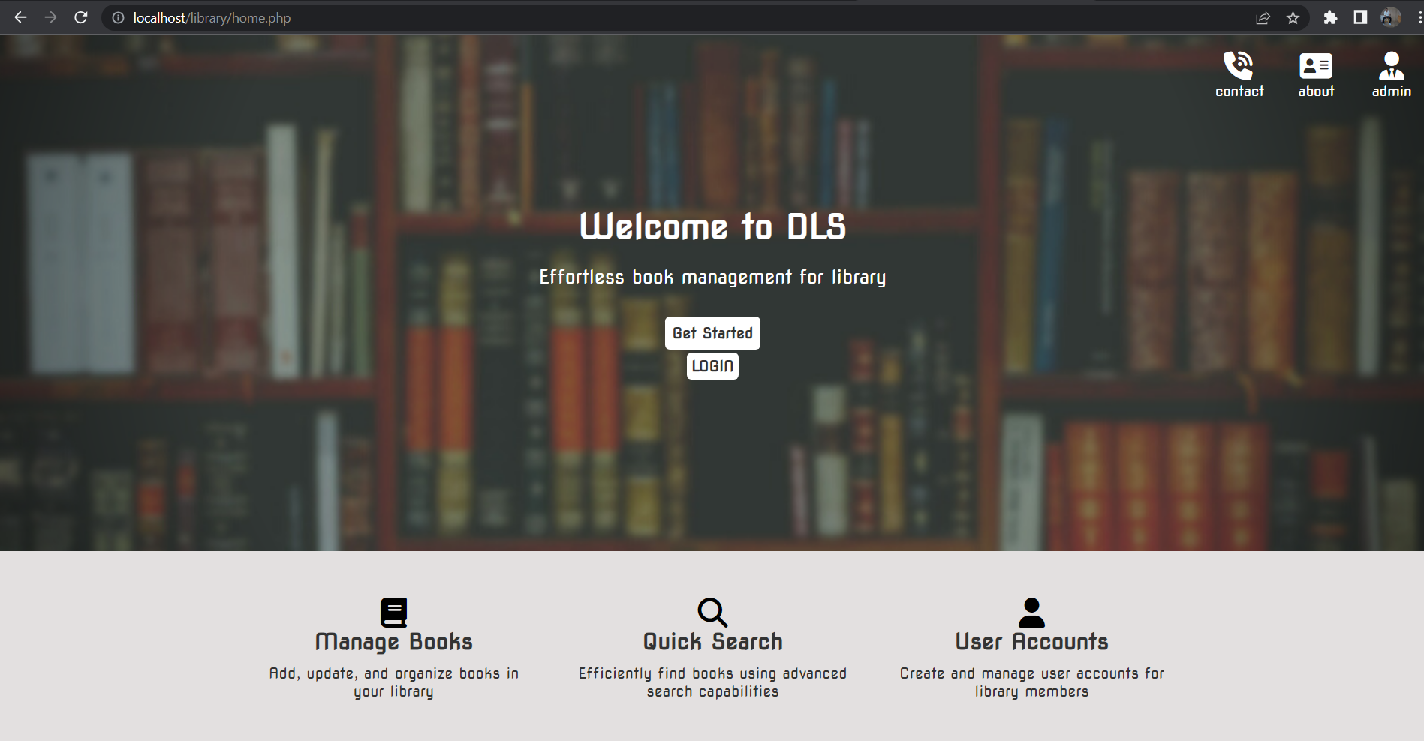
Screenshots Home Page

Slide 10
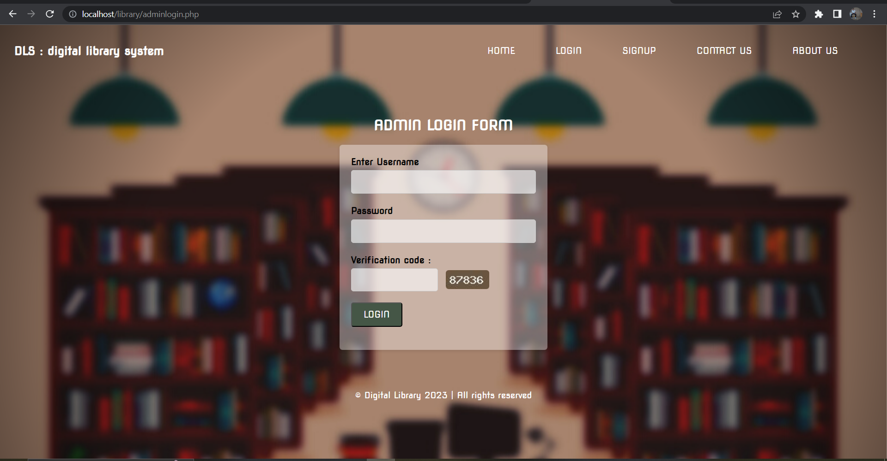
Admin Login

Slide 11
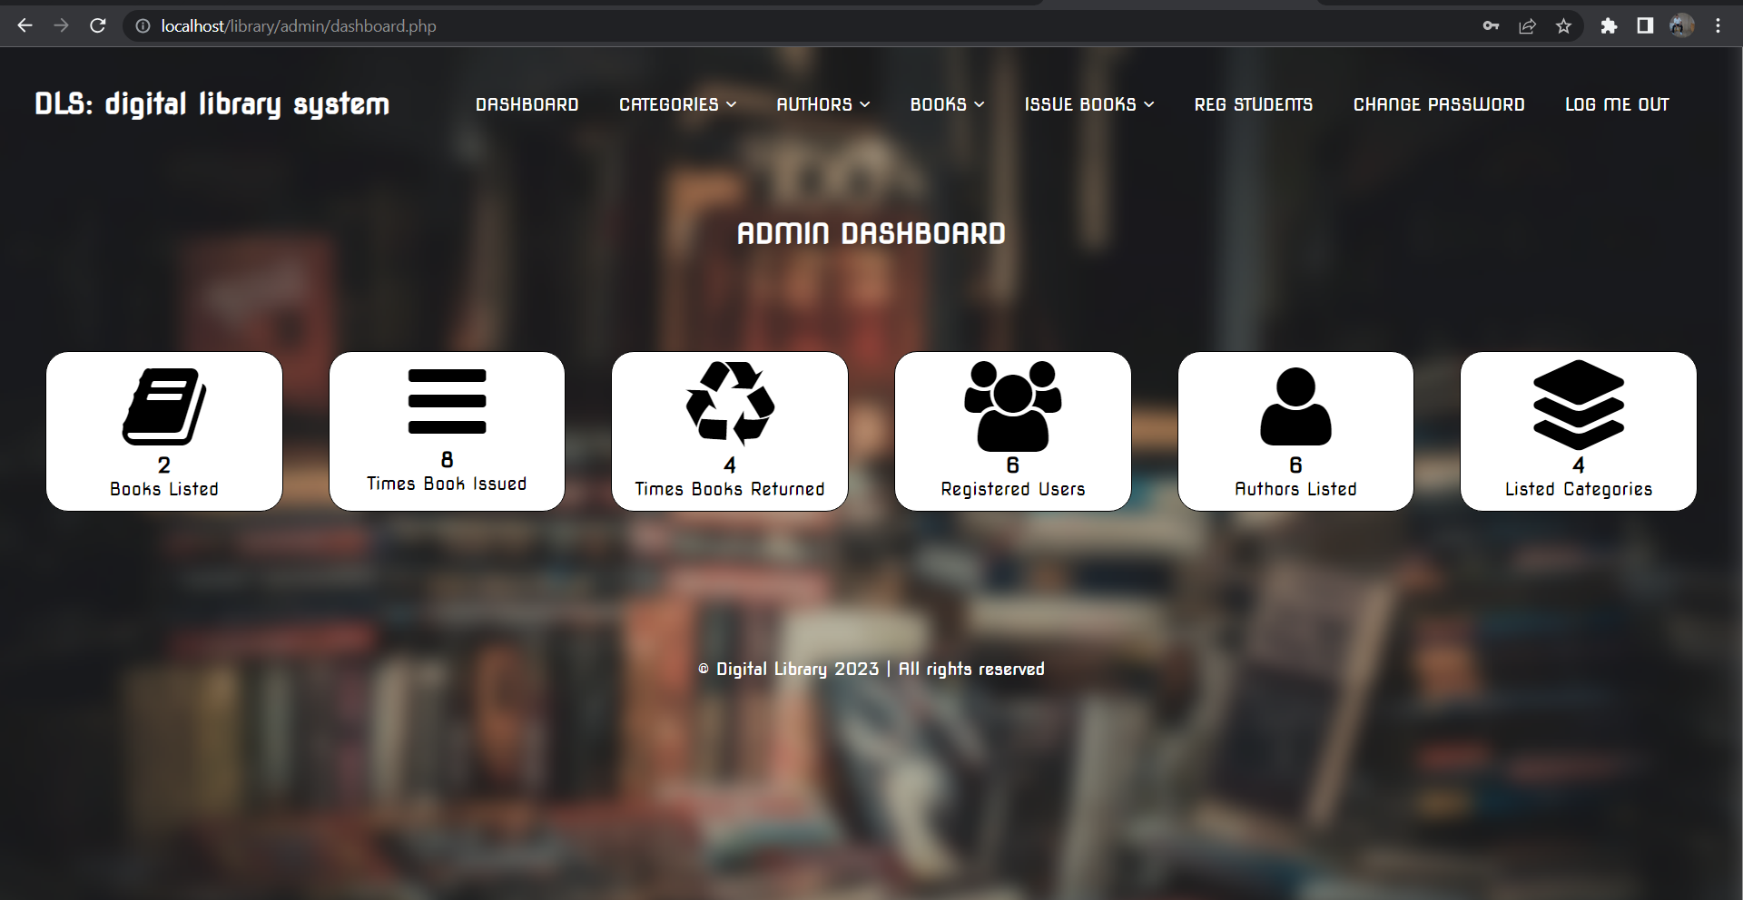
Admin Dashboard

Slide 12
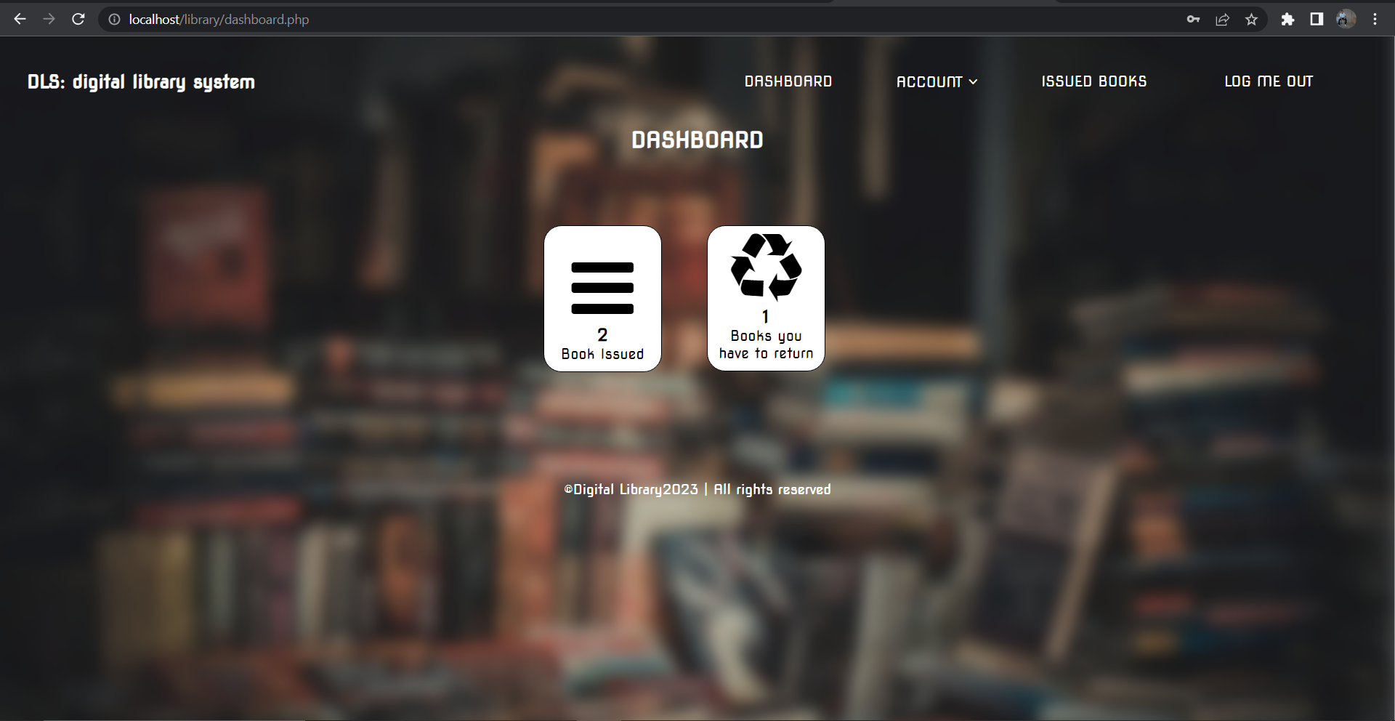
User Dashboard

Slide 13


Conclusion
the Digital Library System (DLS) is a comprehensive solution that aims to automate and streamline library management processes. The system provides a user-friendly interface for both library staff and members, enabling efficient book management, user account management, and borrowing operations. By leveraging technology and automation, DLS eliminates manual paperwork, reduces administrative overhead, and enhances the overall user experience.
Digital Library System is a valuable tool for modern libraries, providing automation, efficiency, and convenience in managing library resources and serving library members. The system empowers libraries to adapt to the digital era and deliver an enhanced user experience, fostering a culture of learning and knowledge sharing

Slide 14
References
1)
Conallen, J. (2003). Building Web Applications with UML. Pearson Education, Inc.
2)
Learning Php, Mysql & Javascript by Robin Nixon
3)
PHP & MySQL in easy steps by Mike McGrath

Slide 15

Thank you

